Slide 1
MEMORY ORGANIZATION
1
Memory Hierarchy
Main Memory
Auxiliary Memory
Associative Memory
Cache Memory
Virtual Memory
Memory Management Hardware

Slide 2
Memory Organization
2
Memory Hierarchy
MEMORY HIERARCHY
Memory Hierarchy is to obtain the highest possible
access speed while minimizing the total cost of the memory system
Auxiliary memory
Magnetic
tapes
I/O processor
Main memory
Magnetic
disks
CPU
Cache memory
Register
Cache
Main Memory
Magnetic Disk
Magnetic Tape

Slide 3
Memory Unit is an essential component in any digital computer since it is needed for storing programs and data. Memory is just like a brain which is useful for storing information into the computer.
Several types of memory are there:
Main memory/Primary memory/Volatile memory is used to communicate directly with the CPU. CPU is mainly used to execute any task into the computer. CPU can execute only that program which will be present into the main memory. If we are going to save any program by default it get saved into the secondary memory but during execution DMA/Operating system transfers the program to primary memory.
Auxiliary memory/secondary memory/Non-volatile memory is used to store the data permanently into the computer. Examples are Magnetic disk and Magnetic tapes. Previously everyone is using magnetic tapes but now a days magnetic disks are used. CPU cannot access the data of auxiliary memory.
Cache memory is small and faster memory which has higher accessibility. Cache memory is very fast memory and size of the memory is very small. It is mainly used to store the data which is frequently used. Main memory access time is slower but cache memory access time is fast. So if there are any frequently used instructions then operating system/IO transfers the instructions of main memory to cache memory so that access will be fast.
I/O processor is mainly used to transfer the data from secondary memory to main memory.

Slide 4
Memory Organization
3
Main Memory
MAIN MEMORY
RAM and ROM Chips
Typical RAM chip
Types of Memory
Static
Dynamic
Chip select 1
Chip select 2
Read
Write 7-bit address
 | CS1 CS2 _{RD} 128 x 8 _{WR} RAM AD 7
8-bit data bus
CS1 | CS2 | RD | WR | Memory function | State of data bus
0 | 0 | x | x | Inhibit | High-impedence
0 | 1 | x | x | Inhibit | High-impedence
1 1 | 0 0 | 0 0 | 0 1 | Inhibit Write | High-impedence Input data to RAM
1 1 | 0 1 | 1 x | x x | Read Inhibit | Output data from RAM High-impedence
Typical ROM chip
Uses of ROM
Bootstrap Loader
Computer Startup
Chip select 1
Chip select 2
CS1
CS2
512 x 8
ROM
8-bit data bus
9-bit address
AD 9

Slide 5
The static RAM consists essentially of internal flip-flops that store the binary information. The stored information remains valid as long as power is applied to the unit. It is very fast but the cost is high. Cache memory is designed with the help of SRAM. The dynamic RAM stores the binary information in the form of electric charges that are applied to capacitors. The capacitors are provided inside the chip by MOS transistors. The stored charge on the capacitors tend to discharge with time and the capacitors must be periodically recharged by refreshing the dynamic memory. Refreshing is done by cycling through the words every few milliseconds to restore the decaying charge. The dynamic RAM offers reduced power consumption and larger storage capacity in a single memory chip. The static RAM is easier to use and has shorter read and write cycles. Main memory is designed with the help of DRAM.
RAM is a volatile memory when we switch off the computer the entire contents of memory will be lost but ROM is a permanent memory that means it stores contents permanently. Most portion of the memory is RAM only but less is ROM.
Bootstrap loader: Among other things, the ROM portion of main memory is needed for storing an initial program called a bootstrap loader. The bootstrap loader is a program whose function is to start the computer software operating when power is turned on. Since RAM is volatile, its contents are destroyed when power is turned off. The contents of ROM remain unchanged after power is turned off and on again. The startup of a computer consists of turning the power on and starting the execution of an initial program. Thus when power is turned on, the hardware of the computer sets the program counter to the first address of the bootstrap loader. The bootstrap program loads a portion of the operating system from disk to main memory and control is then transferred to the operating system, which prepares the computer for general use. RAM and ROM chips are available in a variety of sizes. If the memory needed for the computer is larger than the capacity of one chip, it is necessary to combine a number of chips to form the required memory size. To demonstrate the chip interconnection, we will show an example of a 1024 x 8 memory constructed with 128 x 8 RAM chips and 512 x 8 ROM chips.

Slide 6
Memory Organization
4
Main Memory
MEMORY ADDRESS MAP
Address space assignment to each memory chip
Example: 512 bytes RAM and 512 bytes ROM
Component | Hexa | Address bus
 | address | 10 | 9 | 8 | 7 | 6 | 5 | 4 | 3 | 2 | 1
RAM 1 | 0000 - 007F | 0 0 0 0 1 | 0 0 1 1 x | 0 1 0 1 x | x x x x x | x x x x x | x x x x x | x x x x x | x x x x x | x x x x x | x x x x x
RAM 2 | 0080 - 00FF
RAM 3 | 0100 - 017F
RAM 4 | 0180 - 01FF
ROM | 0200 - 03FF
Memory Connection to CPU
- RAM and ROM chips are connected to a CPU
through the data and address buses
- The low-order lines in the address bus select the byte within the chips and other lines in the address bus select a particular chip through its chip select inputs

Slide 7
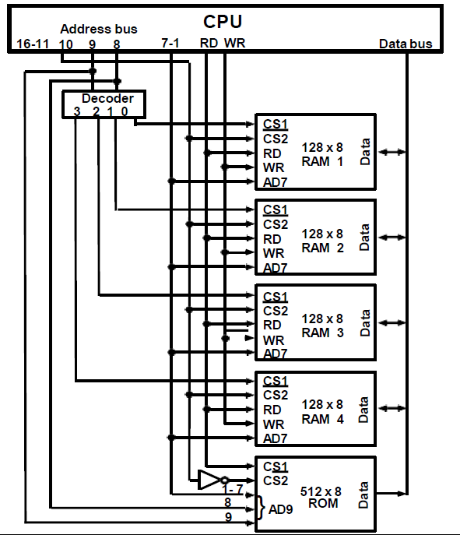
Memory Organization
5
Main Memory
CONNECTION OF MEMORY TO CPU

Slide 8
Memory Organization
6
Auxiliary Memory
AUXILIARY MEMORY
Information Organization on Magnetic Tapes
file i
block 1 block 2
EOF
Characteristics of Auxiliary Memory
R1 _{R2}
block 3
Access Mode
Access Time
Transfer rate
Capacity
Cost
R3 R4
R5
block 3 IRG
R5 R4
R6
EOF
R1
R3 R2
block 1
block 2
Access Time
Seek Time
Transfer Time
Organization of Disk Hardware
Moving Head Disk
Fixed Head Disk
Track

Slide 9

Memory Organization
7
ASSOCIATIVE MEMORY
Associative Memory
Accessed by the content of the data rather than by an address
Also called Content Addressable Memory (CAM)
Hardware Organization
A:
K:
101 111100
111 000000
Argument register(A)
Word 1: 100 111100 (No Match)
Word 2: 101 000001 (Match)
Key register (K)
Match register
Input
Associative memory array and logic
m words
n bits per word
M
Read
Write
Compare each word in CAM in parallel with the
content of A(Argument Register)
If CAM Word[i] = A, M(i) = 1
Read sequentially accessing CAM for CAM Word(i) for M(i) = 1
K(Key Register) provides a mask for choosing a particular field or key in the argument in A (only those bits in the argument that have 1’s in
their corresponding position of K are compared)

Slide 10
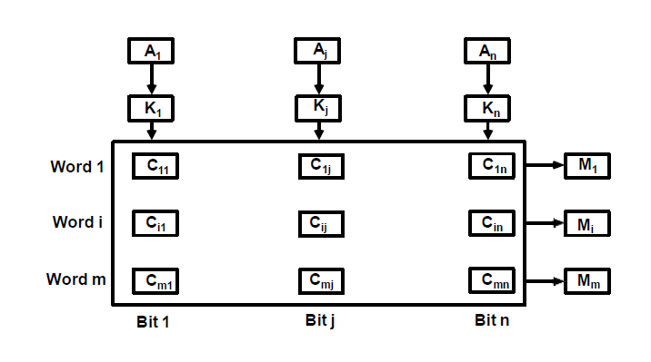
Memory Organization
8
Associative Memory
ORGANIZATION OF CAM

Slide 11



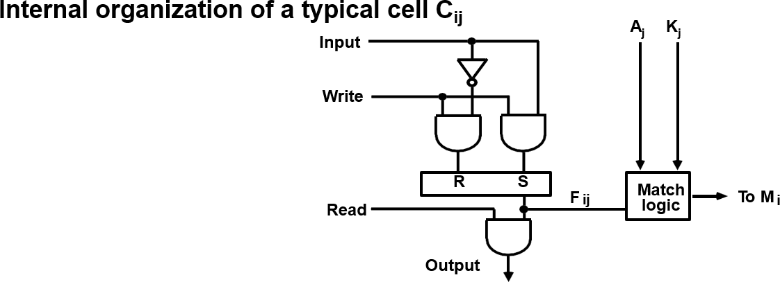
Memory Organization
9
Associative Memory
MATCH
LOGIC
𝒙_{𝒋} = 𝑨_{𝒋}𝑭_{𝒊𝒋} + 𝑨′𝑭′
𝒋 𝒊𝒋
𝑴_{𝒊} = 𝒙_{𝟏}𝒙_{𝟐}𝒙_{𝟑} … 𝒙_{𝒏}

Slide 12






Memory Organization
10
Associative Memory
MATCH
LOGIC
K₁
A₁
K₂
A₂
K_{n}
A_{n}
F'_{i1}
F i1
F'_{i2}
^{F} i2
. . . .
F'in Fin
M _{i}

Slide 13
Memory Organization
11
Cache Memory
CACHE MEMORY
Locality of Reference
The references to memory at any given time interval tend to be confined within a localized areas
This area contains a set of information and the membership changes gradually as time goes by
Temporal Locality
The information which will be used in near future is likely to be in use already (e.g. Reuse of information in loops)
Spatial Locality
If a word is accessed, adjacent(near) words are likely accessed soon (e.g. Related data items (arrays) are usually stored together; instructions are executed sequentially)
Cache
The property of Locality of Reference makes the Cache memory systems work
Cache is a fast small capacity memory that should hold those information which are most likely to be accessed
Main memory
CPU
Cache memory

Slide 14
Memory Organization
12
Cache Memory
PERFORMANCE OF CACHE
Memory Access
All the memory accesses are directed first to Cache
If the word is in Cache; Access cache to provide it to CPU
If the word is not in Cache; Bring a block (or a line) including
that word to replace a block now in Cache
How can we know if the word that is required
is there ?
If a new block is to replace one of the old blocks, which one should we choose ?
Performance of Cache Memory System
Hit Ratio - % of memory accesses satisfied by Cache memory system Te: Effective memory access time in Cache memory system
Tc: Cache access time
Tm: Main memory access time
Te = Tc + (1 - h) Tm
Example: Tc = 0.4 μs, Tm = 1.2μs, h = 0.85
Te = 0.4 + (1 - 0.85) * 1.2 = 0.58μs

Slide 15

Memory Organization
12
Cache Memory
MEMORY AND CACHE | MAPPING - ASSOCIATIVE MAPPLING -
Mapping Function Specification of correspondence between main memory blocks and cache blocks Associative mapping Direct mapping Set-associative mapping Associative Mapping Any block location in Cache can store any block in memory -> Most flexible Mapping Table is implemented in an associative memory -> Fast, very Expensive Mapping Table Stores both address and the content of the memory word address (15 bits) Argument register Address Data
CAM | 0 1 0 0 0 | 3 4 5 0
 | 0 2 7 7 7 | 6 7 1 0
 | 2 2 2 3 5 | 1 2 3 4

Slide 16
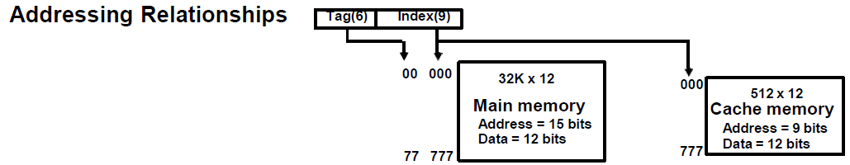
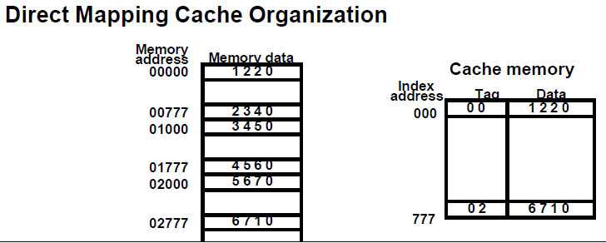
Memory Organization
13
Cache Memory
MEMORY AND CACHE MAPPING-DIRECT MAPPING
-Each memory block has only one place to load in Cache
-Mapping Table is made of RAM instead of CAM
-n-bit memory address consists of 2 parts' bits of Index field and n-k bits of Tag field
-n-bit addresses are used to access main memory and k-bit Index is used to access the Cache

Slide 17
Memory Organization
14
Cache Memory
DIRECT MAPPING
Operation
CPU generates a memory request with (TAG;INDEX)
Access Cache using INDEX ; (tag;
data) Compare TAG and tag
If matches -> Hit
Provide Cache[INDEX](data) to CPU
If not match -> Miss
M[tag;INDEX] <- Cache[INDEX](data)
Cache[INDEX] <- (TAG;M[TAG; INDEX])
CPU <- Cache[INDEX](data)
Direct Mapping with block size of 8 words
Index tag data 6
6
3
Block 0
000 007 | 0 1 0 1 | 3 4 5 0 6 5 7 8
010 017
770 777 | 0 2 0 2 | 6 7 1 0
Tag | Block | Word
INDEX
Block 1
Block 63

Slide 18
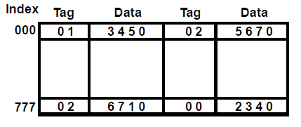
MEMORY AND CACHE MAPPING - SET ASSOCIATIVE MAPPING -
Memory Organization 15 Cache Memory
- Each memory block has a set of locations in the Cache to load
Set Associative Mapping Cache with set size of two
Operation
CPU generates a memory address(TAG; INDEX)
Access Cache with INDEX, (Cache word = (tag 0, data 0); (tag 1, data 1))
Compare TAG and tag 0 and then tag 1
If tag i = TAG -> Hit, CPU <- data i
If tag i ≠ TAG -> Miss,
Replace either (tag 0, data 0) or (tag 1, data 1), Assume (tag 0, data 0) is selected for replacement, (Why (tag 0, data 0) instead of (tag 1, data 1) ?)
M[tag 0, INDEX] <- Cache[INDEX](data 0) Cache[INDEX](tag 0, data 0) <- (TAG, M[TAG,INDEX]),
CPU <- Cache[INDEX](data 0)

Slide 19
Memory Organization
16
Cache Memory
BLOCK REPLACEMENT POLICY
Many different block replacement policies are available
LRU(Least Recently Used) is most easy to implement
Cache word = (tag 0, data 0, U0);(tag 1, data 1, U1), Ui = 0 or 1(binary)
Implementation of LRU in the Set Associative Mapping with set size = 2
Modifications
Initially all U0 = U1 = 1
When Hit to (tag 0, data 0, U0), U1 <- 1(least recently used) (When Hit to (tag 1, data 1, U1), U0 <- 1(least recently used)) When Miss, find the least recently used one(Ui=1)
If U0 = 1, and U1 = 0, then replace (tag 0, data 0)
M[tag 0, INDEX] <- Cache[INDEX](data 0)
Cache[INDEX](tag 0, data 0, U0) <- (TAG,M[TAG,INDEX], 0); U1 <- 1
If U0 = 0, and U1 = 1, then replace (tag 1, data 1)
Similar to above; U0 <- 1
If U0 = U1 = 0, this condition does not exist If U0 = U1 = 1, Both of them are candidates,
Take arbitrary selection

Slide 20
Memory Organization
17
Cache Memory
CACHE WRITE
Write Through
When writing into memory
If Hit, both Cache and memory is written in parallel
If Miss, Memory is written
For a read miss, missing block may be overloaded onto a cache block
Memory is always updated
-> Important when CPU and DMA I/O are both executing
Slow, due to the memory access time
Write-Back (Copy-Back)
When writing into memory
If Hit, only Cache is written
If Miss, missing block is brought to Cache and write into Cache
For a read miss, candidate block must be
written back to the memory
Memory is not up-to-date, i.e., the same item in
Cache and memory may have different value

Slide 21
Memory Organization
18
Virtual Memory
VIRTUAL MEMORY
Give the programmer the illusion that the system has a very large memory,
even though the computer actually has a relatively small main memory
Address Space(Logical) and Memory Space(Physical)
address space
memory space
virtual address (logical address)
Mapping
physical address
address generated by programs actual main memory address
Address Mapping
Memory Mapping Table for Virtual Address -> Physical Address
Virtual address
Memory mapping table
Main memory
Virtual address register
Main memory address register
Physical
Address
Memory table
buffer register
Main memory
buffer register

Slide 22
Memory Organization
19
Virtual Memory
ADDRESS MAPPING
Address Space and Memory Space are each divided into fixed size group of words called blocks or pages
1K words group
Page 0
Page 1
Page 2
Page 3
Page 4
Page 5
Page 6
Page 7
Address space N = 8K = 2¹³
Memory space
M = 4K = 2¹²
Block 0
Block 1
Block 2
Block 3
Organization of memory Mapping Table in a paged system
Page no. Line number
1 0 1
0 1 0 1 0 1 0 0 1 1
Virtual address
Table address
Presence
bit
000
 |  | 0
11 |  | 1
00 |  | 1
 |  | 0
 |  | 0
01 |  | 1
10 |  | 1
 |  | 0
Main memory
001
010
011
100
101
110
111
Block 0
Block 1
Block 2
Block 3
0 1
0 1 0 1 0 1 0 0 1 1
Main memory address register
Memory page table
MBR
01
1

Slide 23
ASSOCIATIVE MEMORY PAGE TABLE
Memory Organization 20
Virtual Memory
Assume that
Number of Blocks in memory = m
Number of Pages in Virtual Address Space = n
Page Table
- Straight forward design -> n entry table in memory
Inefficient storage space utilization
<- n-m entries of the table is empty
- More efficient method is m-entry Page Table Page Table made of an Associative Memory m words; (Page Number:Block Number)
Virtual address
Page no.
1 0 1 Line number Argument register
1 0 1 0 0 Key register
Associative memory
0 | 0 | 1 | 1 | 1
0 | 1 | 0 | 0 | 0
1 | 0 | 1 | 0 | 1
1 | 1 | 0 | 1 | 0
Page no.Block no.
Page Fault
Page number cannot be found in the Page Table

Slide 24
Memory Organization
21
Virtual Memory
PAGE FAULT
3 Page is on backing store
Trap to the OS
Save the user registers and program state
Determine that the interrupt was a page fault
Check that the page reference was legal and
determine the location of the page on the
backing store(disk)
Issue a read from the backing store to a free
frame
Wait in a queue for this device until serviced
Wait for the device seek and/or latency time
Begin the transfer of the page to a free frame
While waiting, the CPU may be allocated to
some other process
Interrupt from the backing store (I/O completed)
OS
2
trap
LOAD M
1 Reference
6
restart
instruction
0
 | free frame
4
bring in missing page
5
reset page table
Save the registers and program state for the other user
Determine that the interrupt was from the backing store
Correct the page tables (the desired page is now in memory)
Wait for the CPU to be allocated to this process again
Restore the user registers, program state, and new page table, then resume the interrupted instruction.
main memory
Processor architecture should provide the ability
to restart any instruction after a page fault.

Slide 25
Memory Organization
22
Virtual Memory
PAGE REPLACEMENT
Decision on which page to displace to make room for an incoming page when no free frame is available
Modified page fault service routine
Find the location of the desired page on the backing store
Find a free frame
If there is a free frame, use it
Otherwise, use a page-replacement algorithm to select a victim
Write the victim page to the backing store
Read the desired page into the (newly) free frame
frame
4. Restart the user process
valid/ invalid bit
victim
frame
swap out
1 victim
page
f 0 | v i
f | v
² change to
invalid
4
reset page table for new page
3
swap desired page in
page table
backing store
physical memory

Slide 26
PAGE REPLACEMENT ALGORITHMS
Memory Organization 23
Virtual Memory
FIFO
Reference string
7 0 1 2 0 3 0 4 2 3 0 3 2 1 2 0 1 7 0 1
7
7
0
7
0
1
2
0
1
2
3
1
2
3
0
4
3
0
4
2
0
4
2
3
0
2
3
0
1
3
0
1
2
7
1
2
7
0
2
7
0
1
Page frames
FIFO algorithm selects the page that has been in memory the longest time
Using a queue - every time a page is loaded, its
identification is inserted in the queue
-
Easy to implement
May result in a frequent page fault
Optimal Replacement (OPT) - Lowest page fault rate of all algorithms
Replace that page which will not be used for the longest period of time
Reference string
7 0 1 2 0 3 0 4 2 3
0 3 2 1 2 0
1 7 0 1
7
7
0
7
0
1
2
0
1
2
0
3
2
4
3
2
0
3
2
0
1
7
0
1
Page frames

Slide 27
PAGE REPLACEMENT ALGORITHMS
Memory Organization 24
Virtual Memory
LRU
OPT is difficult to implement since it requires future knowledge
LRU uses the recent past as an approximation of near future.
Replace that page which has not been
used for the longest period of time
Reference string
7 0 1 2 0 3 0 4 2 3 0 3 2 1 2 0 1 7 0 1
7
7
0
7
0
1
2
0
1
2
0
3
4
0
3
4
0
2
4
3
2
0
3
2
1
3
2
1
0
2
1
0
7
Page frames
LRU may require substantial hardware assistance
The problem is to determine an order for the frames
defined by the time of last use

Slide 28
PAGE REPLACEMENT ALGORITHMS
Memory Organization 25
Virtual Memory
LRU Implementation Methods
Counters
For each page table entry - time-of-use register
Incremented for every memory reference
Page with the smallest value in time-of-use register is replaced
Stack
Stack of page numbers
Whenever a page is referenced its page number is removed from the stack and pushed on top
Least recently used page number is at the bottom
Reference string
4 7 0 7 1 0 1 2 1 2 7 1 2
2
1
0
7
4
7
2
1
0
4
LRU Approximation
Reference (or use) bit is used to approximate the LRU
Turned on when the corresponding page is
referenced after its initial loading
Additional reference bits may be used

Slide 29
MEMORY MANAGEMENT HARDWARE
Memory Organization 26 Memory Management Hardware
Basic Functions of MM
Dynamic Storage Relocation - mapping logical
memory references to physical memory references
Provision for Sharing common information
stored in memory by different users
Protection of information against unauthorized access
Segmentation
- A segment is a set of logically related instructions or data elements associated with a given name
- Variable size
User's view of memory
The user does not think of memory as a linear array of words. Rather the user prefers to view memory as a collection of variable sized segments, with no necessary ordering among segments.
Stack
Subroutine
Symbol Table
SQRT
Main
Program
User's view of a program

Slide 30
Memory Organization
27
Memory Management Hardware
SEGMENTATION
A memory management scheme which supports
user's view of memory
A logical address space is a collection of segments
Each segment has a name and a length
Address specify both the segment name and the offset within the segment.
For simplicity of implementations, segments are numbered.
Segmentation Hardware
Segment Table
s
limit
base
CPU
(s,d)
Memory
<
y
+
n
error

Slide 31


SEGMENTATION EXAMPLE
Memory Organization
28 Memory Management Hardware
Segment 0
Segment 3
Segment 2
Segment 4
Segment 1
Subroutine
Segment 0
Stack
Segment 3
1400
2400
Symbol Table
Segment 4
3200
SQRT
Segment 1
Main
Program
Segment 2
4300
4700
Logical Address Space
5700
6300
6700
Segment Table
limit | base
1000 400 400 1100 1000 | 1400 6300 4300 3200 4700
0
1
2
3
4

Slide 32



SHARING OF SEGMENTS
Memory Organization
29 Memory Management Hardware
Editor
Editor
Data 1
Data 2
limit | base
25286 | 43062
4425 | 68348
43062
Segment 0
0
1
Data 1
Segment Table
(User 1)
68348
72773
Segment 1
Logical Memory
(User 1)
90003
98556
Editor
limit | base
25286 | 43062
8550 | 90003
0
1
Segment 0
Physical Memory
Data 2
Segment Table (User 2)
Segment 1
Logical Memory
(User 2)

Slide 33
SEGMENTED PAGE SYSTEM
Memory Organization
30 Memory Management Hardware
Logical address
Segment
Page
Word
Segment table
Page table
+
Block
Word
Physical address

Slide 34
IMPLEMENTATION OF PAGE AND SEGMENT TABLES
Memory Organization 31 Memory Management Hardware
Implementation of the Page Table
Hardware registers (if the page table is reasonably small)
Main memory
Page Table Base Register(PTBR) points to PT
Two memory accesses are needed to access
a word; one for the page table, one for the word
- Cache memory (TLB: Translation Lookaside Buffer)
- To speedup the effective memory access time, a special small memory called associative memory, or cache is used
Implementation of the Segment Table Similar to the case of the page table

Slide 35
Memory Organization
32
Memory Management Hardware
EXAMPLE
Logical and Physical Addresses
Logical address format: 16 segments of 256 pages
each, each page has 256words
4 8 8
Segment | Page | Word
2²⁰ x 32
Physical
memory
Physical address format: 4096 blocks of 256 words
each, each word has 32bits
12 8
Block Word
Logical and Physical Memory Address Assignment
Hexa
address
60000
60100
60200
60300
60400
604FF
Page number
Page 0
Page 1
Page 2
Page 3
Page 4
Segment Page | Block
6 00 6 01 6 02 6 03 6 04 | 012 000 019 053 A61
(a) Logical address assignment
(b) Segment-page versus
memory block assignment

Slide 36
LOGICAL TO PHYSICAL MEMORY MAPPING
Memory Organization 33 Memory Management Hardware
Segment and page table mapping
Logical address (in hexadecimal)
6 | 02 | 7E
Segment table
Page table
00000
000FF
Physical memory
0
35
A3
00
012
000
019
053
A61
012
Block 0
Block 12
32-bit word
6
35
36
37
38
39
01200
012FF
F
01900
0197E
019FF
A3
Associative memory mapping
Segment | Page | Block
6 | 02 | 019
6 | 04 | A61

Slide 37
Memory Organization
34
Memory Management Hardware
MEMORY PROTECTION
Protection information can be included in the
segment table or segment register of the memory
management hardware
- Format of a typical segment descriptor
Base address | Length | Protection
The protection field in a segment descriptor specifies
the Access Rights to the particular segment
In a segmented-page organization, each entry in the page table may have its own protection field to describe the Access Rights of each page
Full read and write privileges. Read only (write protection) Execute only (program protection) System only (O.S. Protection)
- Access Rights:

Slide 38
Q1. i.) How many 128 × 8 RAM chips are needed to provide a memory capacity of 2048 bytes?
ii.) How many lines of the address bus must be used to access 2048 byte of memory? How many of these lines will be common to all chips?
iii.) How many lines must be decoded for chip select? Specify the size of the decoders?
According to question, 128 x 8 RAM = 1024 bits and 1 bit = 1/8Byte Thus, 1024 bits = 1024 /8 = 128 Byte
1 RAM chip = 128 Byte
Lets consider there are n number of Chips to provide 2048 Bytes
Now, 1RAM Chip = 128 Byte
128n = 2048
n = 16 Therefore, 16 Chips will be needed to provide memory capacity of 2048 bytes.
2048 ( 2¹¹ ) locations needs same address lines as one need bits for representing 2048 11 lines of address bus required to access 2048 bytes of memory.
Here chips are of 128x8 in size,
128 ( 2⁷ ) locations means we need 7 address lines. Therefore 11 lines of address bus required to access 2048 bytes of memory. And 7 address lines will be common to all chips.
iii) 4 address lines must be decoded to select the right chip. 4 address lines will need 16 chips, Size of decoder = 4x16.

Slide 39
Q2. A computer uses RAM chips of 1024 x 1 capacity.
How many chips are needed and how should their address lines be connected to provide a memory capacity of 1024 bytes?
How many chips are needed to provide a memory capacity of 16K bytes?
Explain in words how the chips are to be connected to the address bus.
As given available chips = 1024 x 1 capacity and Required capacity = 1024 x 8 capacity Number of Chips=(1024X8)/(1024X1) = 8
(ii) Number Of Chips Required = (16X1024X8)/(1024X1) = 128
(iii) Use 14 address lines (16 k = 2¹⁴)
10 lines specify the chip address
4 lines are decoded into 16 chip-select inputs.

Slide 40
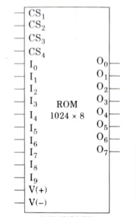
Q3. A ROM chip of 1024*8 has four select inputs and operates from a 5 volt power supply. How many pins are needed for the IC package ? Draw a block diagram and label all input and output terminals in the ROM.
Size of ROM Chip = 1024 x 8
Number of input = 10 pin [2¹⁰ = 1024]
Number of output = 8 pin
Number of chip select = 4 pin
Power = 2 pin
Total 24 pins are required.

Slide 41
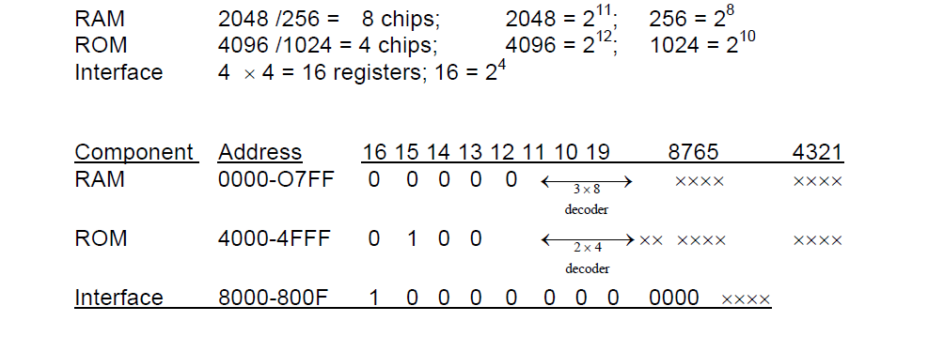
Q5. A computer employs RAM chips of 256 x 8 and ROM chips of 1024 x 8. the computer system needs 2k bytes of RAM, 4k bytes of ROM, and four interface units, each with four registers. a memory-mapped I/O configuration is used. the two highest-order bits of the address bus are assigned 00 for RAM, 01 for ROM, and 10 for interface registers.
How many ram and ROM chips are needed?
Draw a memory-address map for the system.
Give the address range in hexadecimal for RAM, ROM, and interface.

Slide 42
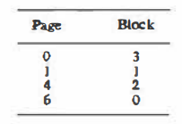
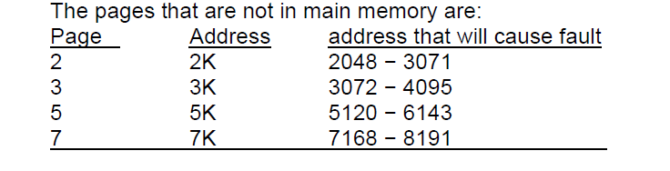
Q20. A virtual memory has a page size of 1K words. There are eight pages and four blocks. The associative memory page table contains the following entries:
Make a list of all virtual addresses (In decimal) that will cause a page fault if used by the CPU.

Slide 43
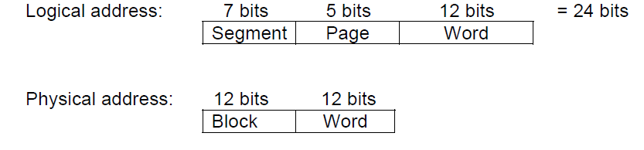
Q23. The logical address space in a computer system consists of 128 segments. Each segment can have up to 32 pages of 4K words in each physical memory consists of 4K blocks of 4K words in each. Formulate the logical and physical address formats.
Logical address space has 128 segments x 32 pages x 4 K words
i.e., 128 X 32 X 4 X 2¹⁰
= 2⁷ x 2⁵ x 2² x 2¹⁰ = 2²⁴ = 24 bit
Physical memory has address space of 4 K blocks x 4 K words
= 4 X 2¹⁰ X 4 X 2¹⁰
= 2²⁴ = 24 bits

